Slide 1

Using OBI in the ISA tool infrastructure
Philippe Rocca-Serra
Oxford University, Oxford, UK
ICBO 2011, OBI workshop, Buffalo, 25-28th July 2011
philippe.roccaserra@oerc.ox.ac.uk
http://www.isa-tools.org

Slide 2
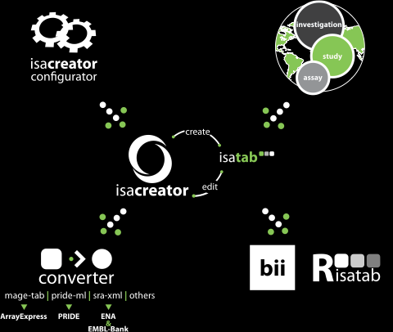
ISA framework overview
Notes:
This an overview of the ISA infrastructure, a set of tools to manage functional genomics and multi-omics experiments.
At the heart lives the ISAcreator, a spreadsheet editor with ontology support. Annotation Requirement can be set by using ISAconfigurator tools
Content validation and Conversion to technology specific formats is ensured by ISAconverter, which is been extended to produced RDF/OWL

Slide 3

A focus on standards...
Notes:
The key concept behind the infrastructure was to allow community focused curation while ensuring annotation standards in terms of requirements are met.
We encourage users to rely on OBO Foundry resources but the tools can be configured to use any vocanulary served by EBI’s OLS or NCBO Bioportal.

Slide 4


ISAcreator Configurator provides configurations to ISAcreator...
These configurations tell ISAcreator what is the minimum amount of information needed to describe experiments.
ISAcreator is packaged with a default configuration, however you can create your own...

Slide 5
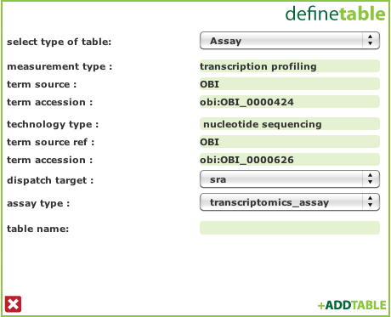
Declaring ISA assays with OBI terms
Assay are defined as a pair of Measurement Type and Technology Type
as in Transcription profiling
using
Nucleotide sequencing
Notes:
OBI provides semantic support in ISA at several levels
First when defining Assay:

Slide 6
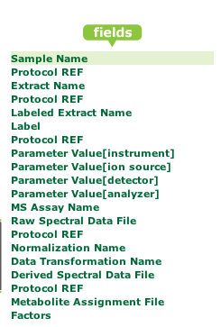
Typing Protocols with OBI terms
Configuration files broadly define assay workflows
Input Material or Data Node
Output Material or Data Node
Protocol REF
Notes:
Then, when defining experimental workflows and declaring the protocols used to process biological materials and data resulting from Assay.
The alignment between ISA syntactic elements and OBI overall layout is very straightforward making the fit natural.
ISAconfiguration tables, such as this one broadly defines a workflow. The key concept that ISA represents Material and Data as Nodes, and it is possible to process one node to produce other node or nodes by applying a protocol (or set of protocols) with associated parameter values. The ISAconfigurator allows users to defined the level of information their community should report. For each assay table constructed in the ISAconfigurator, the field’s data type can be set and…(next slide)

Slide 7
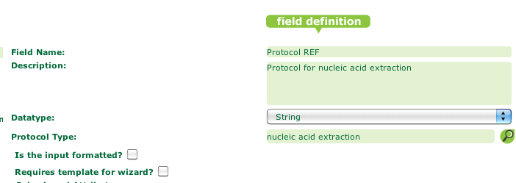
Using OBI terms to type Protocols
Notes:
This next slide shows how to set the protocol type associated to a Protocol REF element in ISA. Note the magnifying glass next to Protocol Type entry. Clicking on it will bring up the ontology widget to enable selection of the Terminology and its navigation to a particular class and associated children.

Slide 8
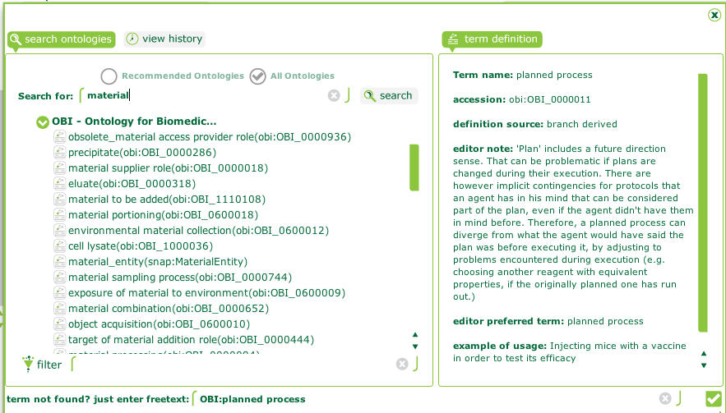
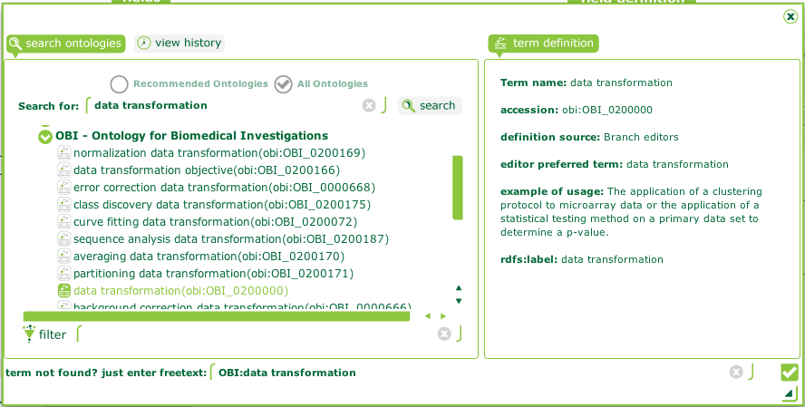
Typing Protocols with OBI terms
Each protocol application between Material Nodes or Data Nodes can be types using OBI from within the tools thanks to the ISA Ontology Browser
Notes:
Here we show how OBI was used to Set of protocol type of material transformation or data transformation

Slide 9
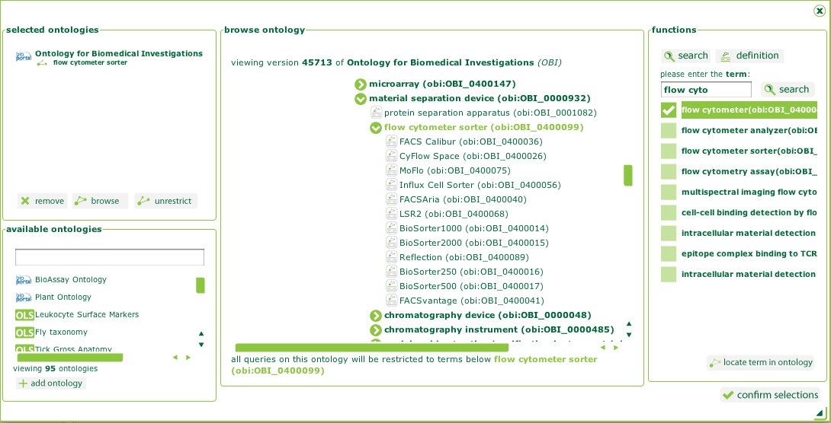
Providing a list of possible valid values for a Parameter, Factor or Characteristics field
Notes:
The ontology widget accesses both NCBO Bioportal and EBI Ontology Lookup Service, (as one can see from the list of resources available in the bottom left hand pane).
One not only can set which ontology (or ontologies) should be used, but one can also restricted to a set of children under a branch.
Here we chose to select all children of Flow Cytometer sorter Class in OBI in order to make sure users of the configuration will use controlled terms.

Slide 10
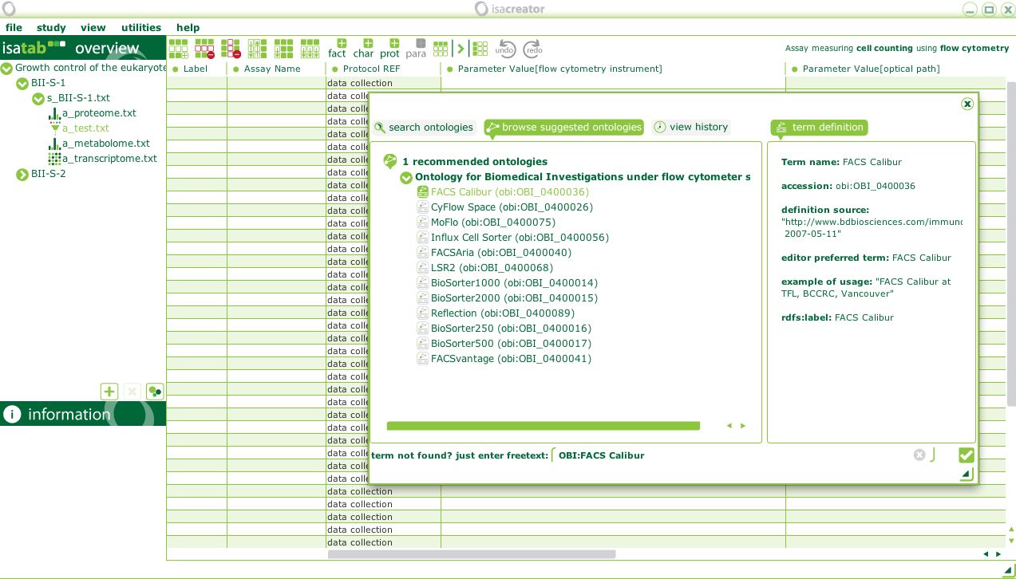
Using the ISAconfiguration in ISAEditor
Notes:
Once a configuration has been defined, ISAcreator Editor can read it the spreadsheet will be aware of the terminonology restrictions a set by the super user in charge of defining annotation requirements. In this screenshot, you can see the allowed values for reporting Flow cytometry instrument using OBI classes in an Flow Cytometry Assay as defined in ISAconfigurator. Note the Metadata pulled from OBI and readily avaiable for people to check the term they select is correct.

Slide 11
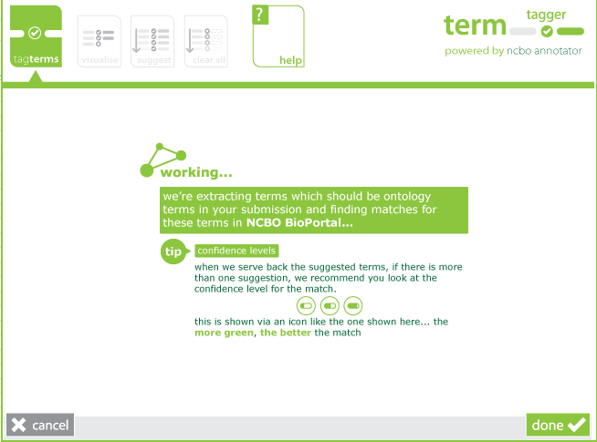
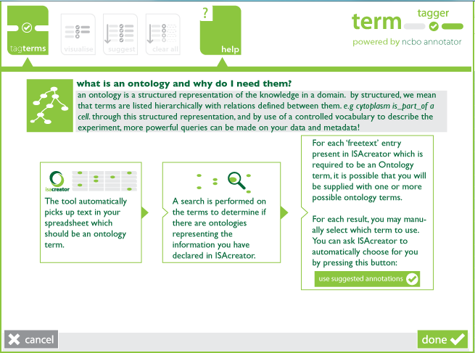
Using the ISAconfiguration in ISAcreator in combination with NCBO Annotator service
Notes:
Users can enter free text when using ISAcreator spreadsheet editor. Still, the tool, in combination with the configuration that tells which ontology or terminology branch should be used can automatically tag free text. This is done by calling NCBO Annotator service from within ISA Editor. (thanks to NCBO Bioportal folks for the service).

Slide 12
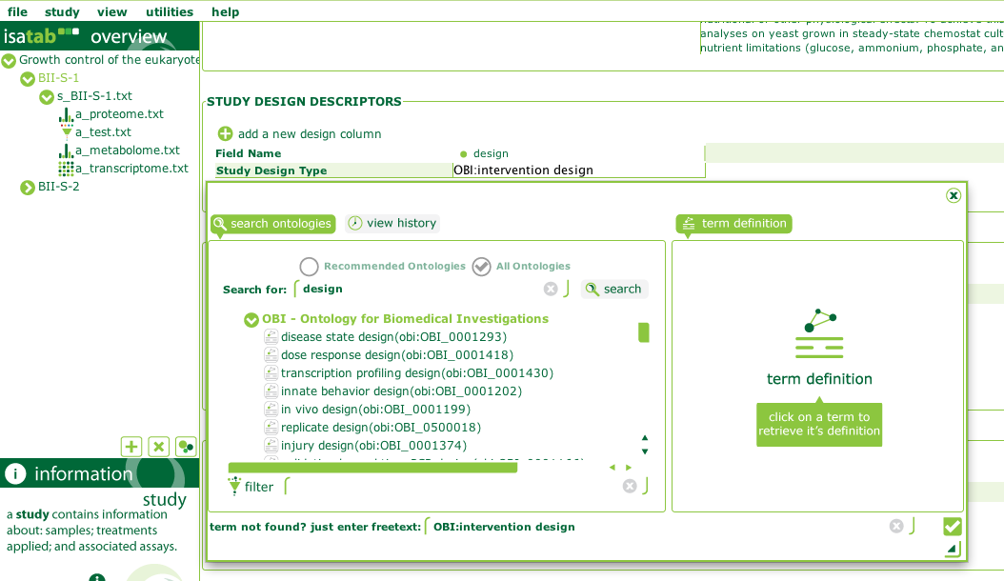
Declaring experimental designs with OBI terms
When using the manual entry, people can select the value of study design
This is automatically set when using the ISA experiment wizard
Notes:
This is a screenshot showing ISAcreator User interface with embedded ontology widget restricted to search terms under OBI study design class.

Slide 13
Future work
Expansion of ISAconverter to provide RDF/OWL representation of experimental data Trivial mapping of ISA elements to OBI classes.
Expansion of the validation rules currently available in ISAvalidator.

Slide 14

Publication...
ISA software suite: supporting standards-compliant experimental annotation and enabling curation at the community level
Philippe Rocca-Serra; Marco Brandizi; Eamonn Maguire; Nataliya Sklyar; Chris Taylor; Kimberly Begley; Dawn Field; Stephen Harris; Winston Hide; Oliver Hofmann; Steffen Neumann; Peter Sterk; Weida Tong; Susanna-Assunta Sansone Bioinformatics 2010 26: 2354-2356

Slide 15
Acknowledgements...
Groups and individuals participating in:
MIBBI http://mibbi.org
OBO Foundry http://obofoundry.org
ISA-Tab format http://isatab.sf.net
ISA Infrastructure Team:
Eamonn Maguire (Oxford)
Philippe Rocca-Serra (Oxford)
Susanna-Assunta Sansone (Oxford)
Chris Taylor (EMBL-EBI)
Alumni:
Marco Brandizi (EMBL-EBI)
Nataliya Sklyar (EMBL-EBI)
collaborators at:
Cambridge University
Harvard School for Public Health
FDAs NCTR
Leibniz Plant Institute
NERCs NEBC
EuNuGO
Funders:
EU Carcinogenomics Project
UK BBSRC

Slide 16
Acknowledgements…
OBI people presenting those slides!

